Slide 1
TRANSCENDENTAL EQUATION SOLVER
04 DEC, 2024

Slide 2
HELLO!
Presented by:
EMAZ ALI KHAN (65566)
ABDUL RAFAY ZAHID (65540)
SUMAIKA ASIF (65651)
Presented To:
Dr. MUHAMMAD ARIF HUSSAIN

Slide 3
AGENDA OVERVIEW
01
02
03
04
05
INTRODUCTION
METHODS
COMPARISON
PROBLEMS
CONCLUSION

Slide 4

INTRODUCTION
This project introduces a Python-based solver designed to find approximate roots of complex equations using five different numerical methods. The presentation will walk through its design, features, and performance in tackling real-world problems.

Slide 5
METHODS
FOR SOLVING LINEAR EQUATIONS
01
BISECTION METHOD
02
REGULA FALSI (FALSE POSITION) METHOD
03
NEWTON'S RAPHSON METHOD
04
MULLER’S METHOD
05
SECANT METHOD

Slide 6
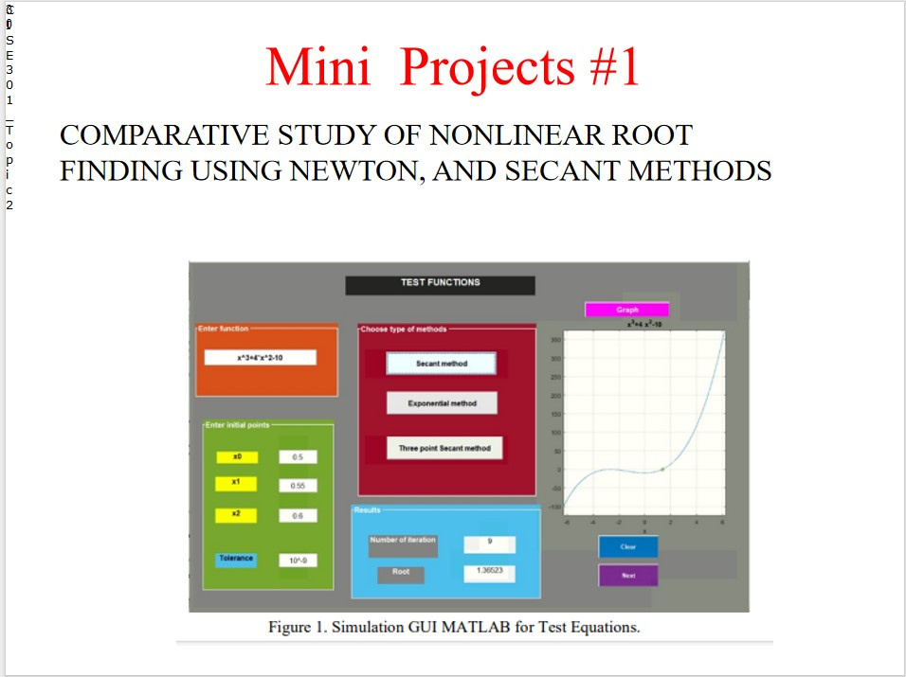
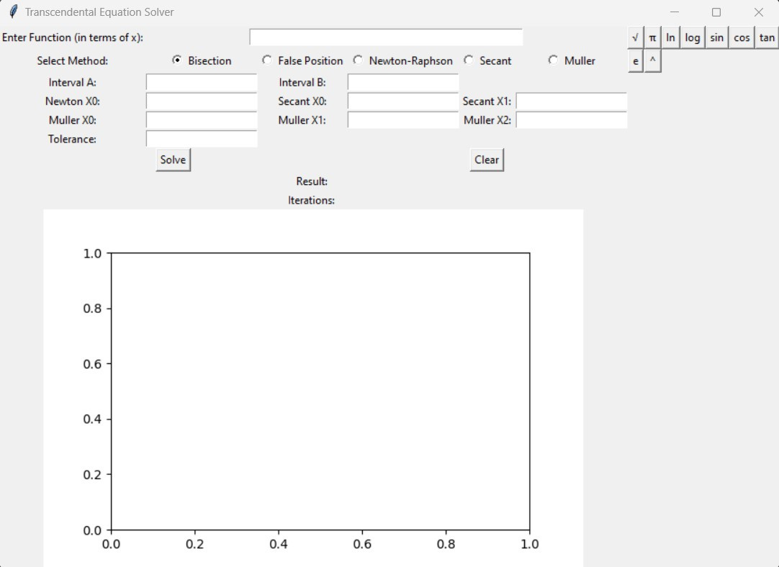
COMPARISON:

Slide 7
PROBLEMS
An electrical engineer needs to determine the precise voltage that minimizes power loss in a circuit. The relationship is modeled by the equation 𝑓(𝑥)=2𝑥3−3𝑥2+𝑥−0.5, where x is the voltage in volts and
𝑓(𝑥) represents power loss in watts. Starting with an initial guess of x0=0 and x1=2 volts and aiming for a final tolerance of 0.000001, the engineer plans to apply the Bisection, Regula Falsi, Newton’s-Raphson, Secant and Muller’s methods to find the optimal voltage.

Slide 8
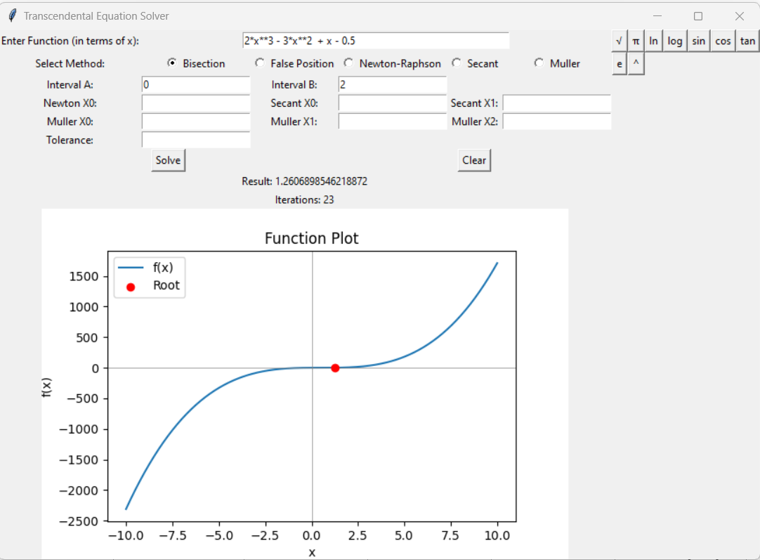
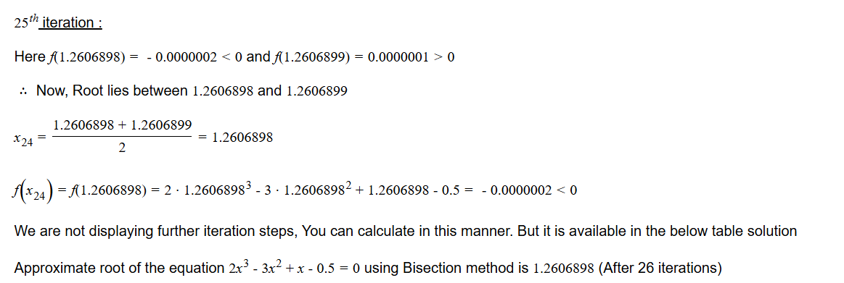
BISECTION METHOD
COMPARE WITH ATOZMATH.COM

Slide 9
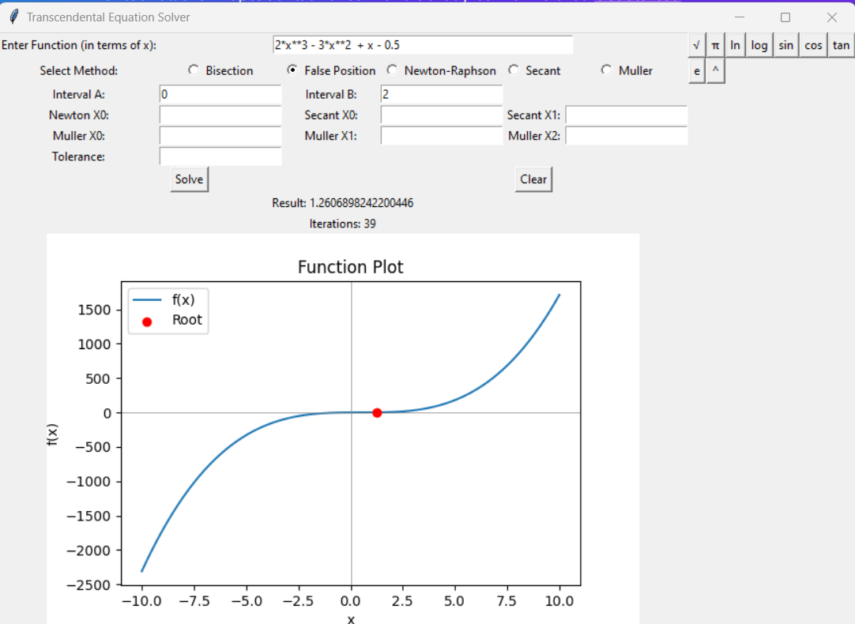
REGULA FALSI METHOD
COMPARE WITH ATOZMATH.COM

Slide 10
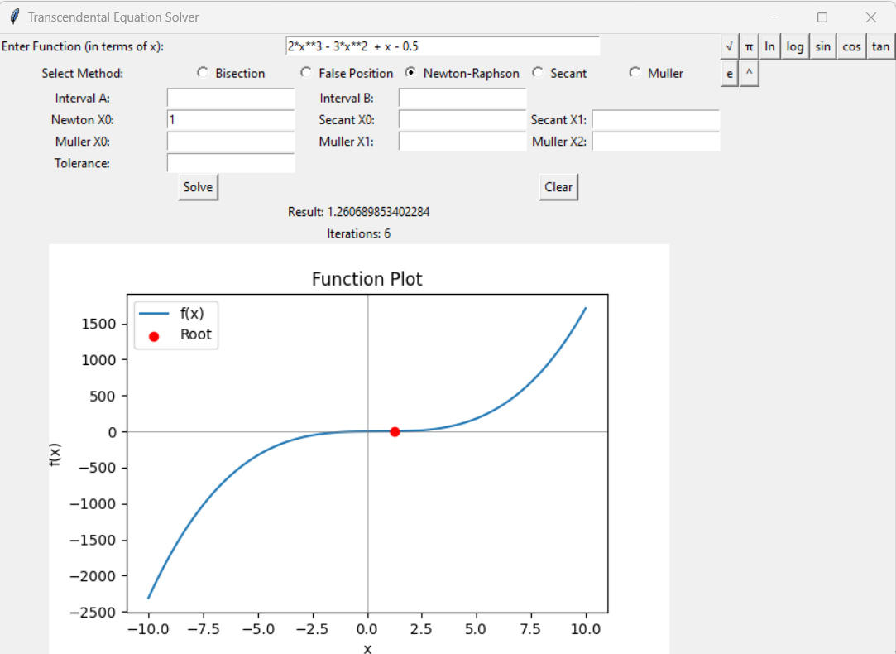
NEWTON’S RALPH METHOD
COMPARE WITH ATOZMATH.COM

Slide 11
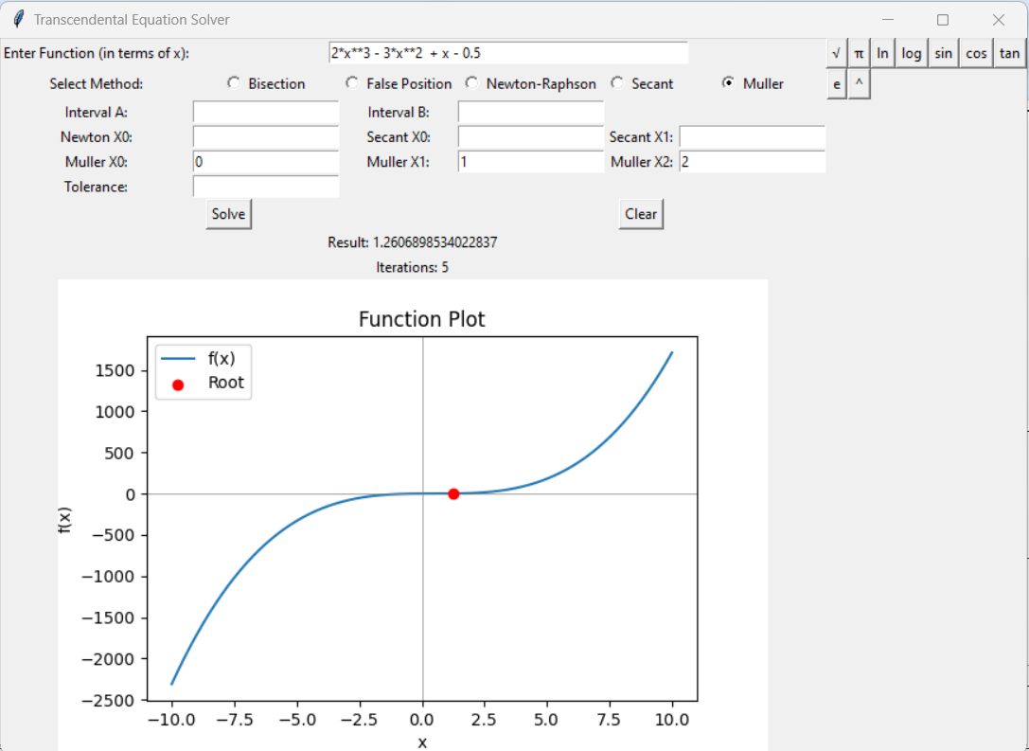
MULLER’S METHOD
COMPARE WITH ATOZMATH.COM

Slide 12
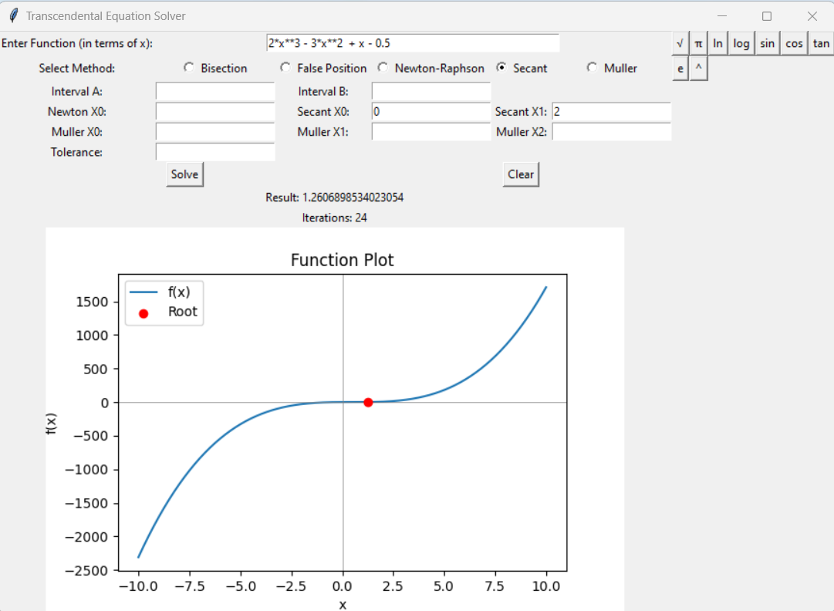
SECANT METHOD
COMPARE WITH ATOZMATH.COM

Slide 13
CONCLUSION:
In conclusion, the Python-based Transcendental Equation Solver efficiently finds approximate roots of complex equations using multiple numerical methods. Its robust design and user-friendly interface offer flexibility and accuracy, making it a valuable tool for solving real-world mathematical problems.

Slide 14
THANK YOU

